Slide 1

Auraria Campus App
Windows 7 Phone application

Slide 2
Introduction
Auraria Campus Application
Windows 7 Phone
No existing competition in the marketplace.
The goal is to bring information about the Auraria campus to Windows phone users in a more convenient native application.
Development Team:
Sokserey Tao
Elijah Gartin

Slide 3
Problem Statement and Proposed Solution
Auraria Campus is a big and diverse campus serving three institutions:
Community College of Denver (CCD)
Metropolitan State University of Denver (MSU Denver)
University of Colorado at Denver (CU Denver)
Offices and classes are spread out over the campus and it is hard to find for new students.
Institutions’ information can be hard to find on the Web.
Smart phones are everywhere with Internet access 24/7.
Therefore, this app is an ideal app to assist students in finding information for the Auraria Campus and their respective institution.

Slide 4
The Product and Goal
Auraria Campus App features:
Campus and institutions’ important information
Campus Map in PDF
Campus Map based on GPS location and user selection.
What features where completed?
Direct links to the institutions’ Website
Location-based Map redirection via Google Map and/or Map App

Slide 5
Key Points
Windows Phone development is streamlined with Visual Studio and the Windows Phone SDK
The consumer will have an easier portal to obtain information about the institutions on campus.
The GPS feature is the highlight feature of the application.
The product will prove to be useful to students on their smart phones especially as each institution makes their website more mobile friendly.
This app has potential to take 100% of the market share in the windows app store as an Auraria campus app.
The project has high potential, therefore continued development is recommended.

Slide 6
The Process
Business Requirements
Prototyping
Wireframes
Implement
VS Windows Phone SDK 7.1
Planning
Functional Requirements
Schema and Data Modeling
Version Control

Slide 7
Planning: Business Requirements
Objective
To create a convenient mobile App for Auraria community
To help students, faculty, and staff to easily and quickly find important information of campus
To be able to use smartphone’s GPS for direction.
To allow the student to download the official campus map.

Slide 8
Planning: Functional Requirement
Simple and easy-to-use App
User can easily navigate through the app
Important information of the campus is provided on the native app
With the phone offline (no Internet service), Campus information and Map are available
With Internet access, user can locate the location of any buildings and direction to the place.
Information updated regularly to reflect any changes.

Slide 9
Prototyping: Wireframes
Demo the prototype
Available on Windows Phone App Store (Free)
You will find the app under these keywords:
Auraria Campus
MSUD
UCD
CCD

Slide 10
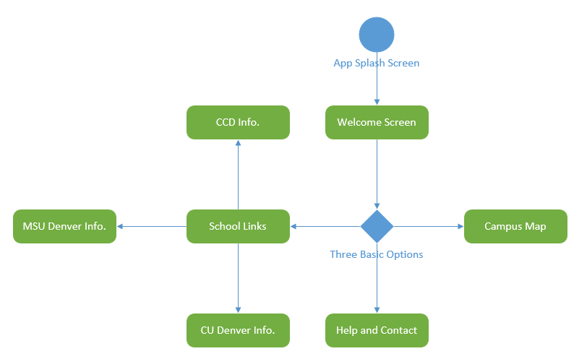
Prototyping: Schema and Data Modeling
Minimalistic Application
Most processing occurs in the Campus Map area
PDF version of map is nearly 7MB
Can be taxing for limited data plans
No back end database required

Slide 11
Implement: Coding with Visual Studio Windows Phone SDK 7.1
Visual Studio 2012 provides an excellent IDE to use with the Windows Phone SDK 7.1 or 8.0
Code written in C#
Easily accessible platform
Tested with Windows Phone Emulator

Slide 12
Implement: Version Control
Current beta version: 0.9
Full version: 1.0
Implement the Upgrade and Update version
1 being upgrade version – for major App’s changes and enhancements
0 being update version – for minor App’s changes and information updates.
Utilized GitHub for version control with multiple programmers
10+ commits were made so far to this project. (revisions)

Slide 13
Future Upgrade and Features
Institution’ information on a scrollable screen
Offline Campus map in the app as an image or PDF
With the location embedded on each buildings
User can tap on a building, and the App will direct user to Map app with the building’s pre-embedded map location and the user’s current location.
Without the Internet access (when Wi-Fi or cellular service turned off), the map will still be available offline for user to use; just without the location tracking.
Help and About Page
Provide manual of the App
Provide contact information and credits to App’s developers.
Platform expansion
iOS Native App
Android Native App
Web-based App

